Slide 1
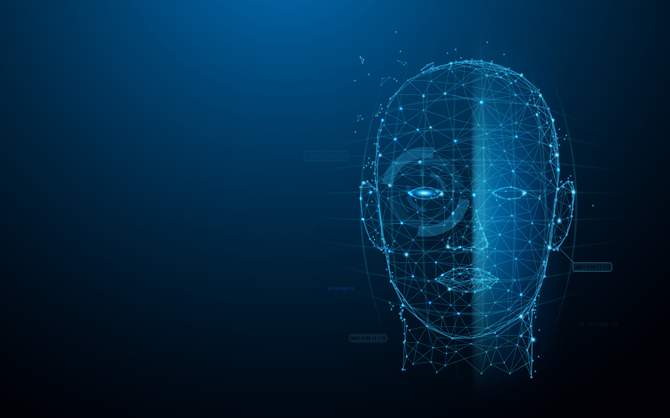
Human Face Recognition Attendance System
Group Name: Exception
Group Member:
Farhat Tasnim – 1410482042 - farhat.tasnim@northsouth.edu
K.M.H.Mubin -1621802042 – kmh.mubin@northsouth.edu

Slide 2
What Is Face Detection?
Face detection is a type of computer vision technology that is able to identify people’s faces within digital images. This is very easy for humans, but computers need precise instructions. The images might contain many objects that aren’t human faces, like buildings, cars, animals, and so on.
It is distinct from other computer vision technologies that involve human faces, like facial recognition, analysis, and tracking.
Facial recognition involves identifying the face in the image as belonging to person X and not person Y. It is often used for biometric purposes, like unlocking your smartphone.
Facial analysis tries to understand something about people from their facial features, like determining their age, gender, or the emotion they are displaying.
Facial tracking is mostly present in video analysis and tries to follow a face and its features (eyes, nose, and lips) from frame to frame. The most popular applications are various filters available in mobile apps like Snapchat.

Slide 3
How Do Computers “See” Images?
The smallest element of an image is called a pixel, or a picture element. It is basically a dot in the picture. An image contains multiple pixels arranged in rows and columns.
You will often see the number of rows and columns expressed as the image resolution. For example, an Ultra HD TV has the resolution of 3840x2160, meaning it is 3840 pixels wide and 2160 pixels high.
But a computer does not understand pixels as dots of color. It only understands numbers. To convert colors to numbers, the computer uses various color models.
In color images, pixels are often represented in the RGB color model. RGB stands for Red Green Blue. Each pixel is a mix of those three colors. RGB is great at modeling all the colors humans perceive by combining various amounts of red, green, and blue.

Slide 4
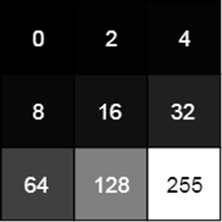
How Do Computers “See” Images?
Since a computer only understand numbers, every pixel is represented by three numbers, corresponding to the amounts of red, green, and blue present in that pixel.
In grayscale (black and white) images, each pixel is a single number, representing the amount of light, or intensity, it carries. In many applications, the range of intensities is from 0 (black) to 255 (white). Everything between 0 and 255 is various shades of gray.
If each grayscale pixel is a number, an image is nothing more than a matrix (or table) of numbers:
In color images, there are three such matrices representing the red, green, and blue channels.

Slide 5
What Are Features?
A feature is a piece of information in an image that is relevant to solving a certain problem. It could be something as simple as a single pixel value, or more complex like edges, corners, and shapes. You can combine multiple simple features into a complex feature.
Applying certain operations to an image produces information that could be considered features as well. Computer vision and image processing have a large collection of useful features and feature extracting operations.
Basically, any inherent or derived property of an image could be used as a feature to solve tasks.

Slide 6







Milestone & TIME FRAME
0%
0%
0%
15%
100%
E
Buying
Products
Image Processing
& apply
Write System
code
Use camera for Image
Processing
Assembling Everything

